Slide 1
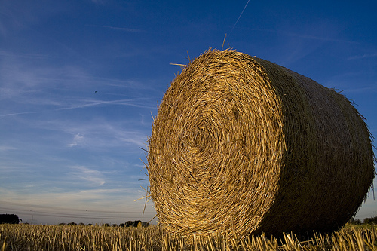
Forage Selection and Quality
Sarah Kenyon
Agronomy Specialist
417-967-4545
KenyonS@missouri.edu

Slide 2
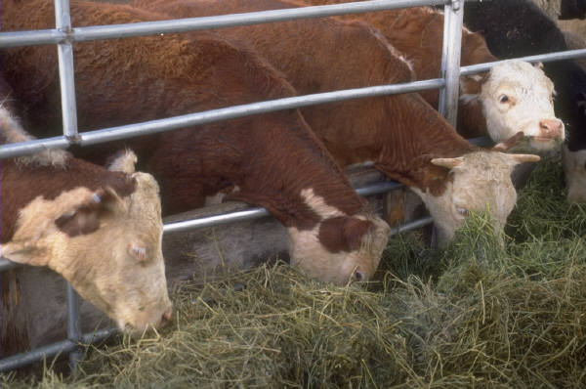
Outline
What can I grow?
  Forage selection
What makes a high quality hay?
  Forage quality

Slide 3
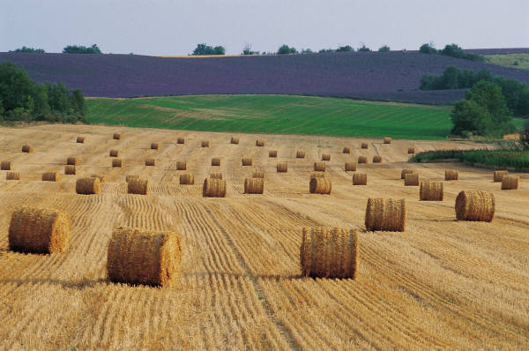
What Can I Grow?

Slide 4
Cool Season Grasses
Perennial Ryegrass
Tall Fescue
Smooth Bromegrass
Forage Growth Rate
Orchardgrass
Feb
Apr
Jun
Aug
Oct
Dec

Slide 5
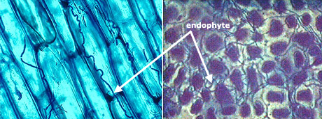
Endophyte Infected Tall Fescue
Fungus found in stem, leaf sheaths & seed
Produces alkaloids toxic to livestock
Increases progressively season long
Minimized in young growth
Roberts and Andrae, 2004

Slide 6
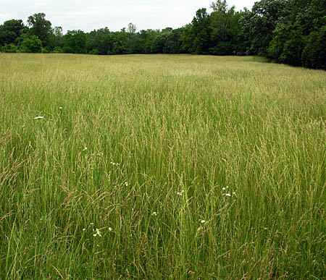
Fescue and the Endophyte
Toxicity from Ergovaline and Total Ergot Alkaloids
  Other alkaloids help with disease, insect, and drought tolerance
Found in seedheads and stems

Slide 7
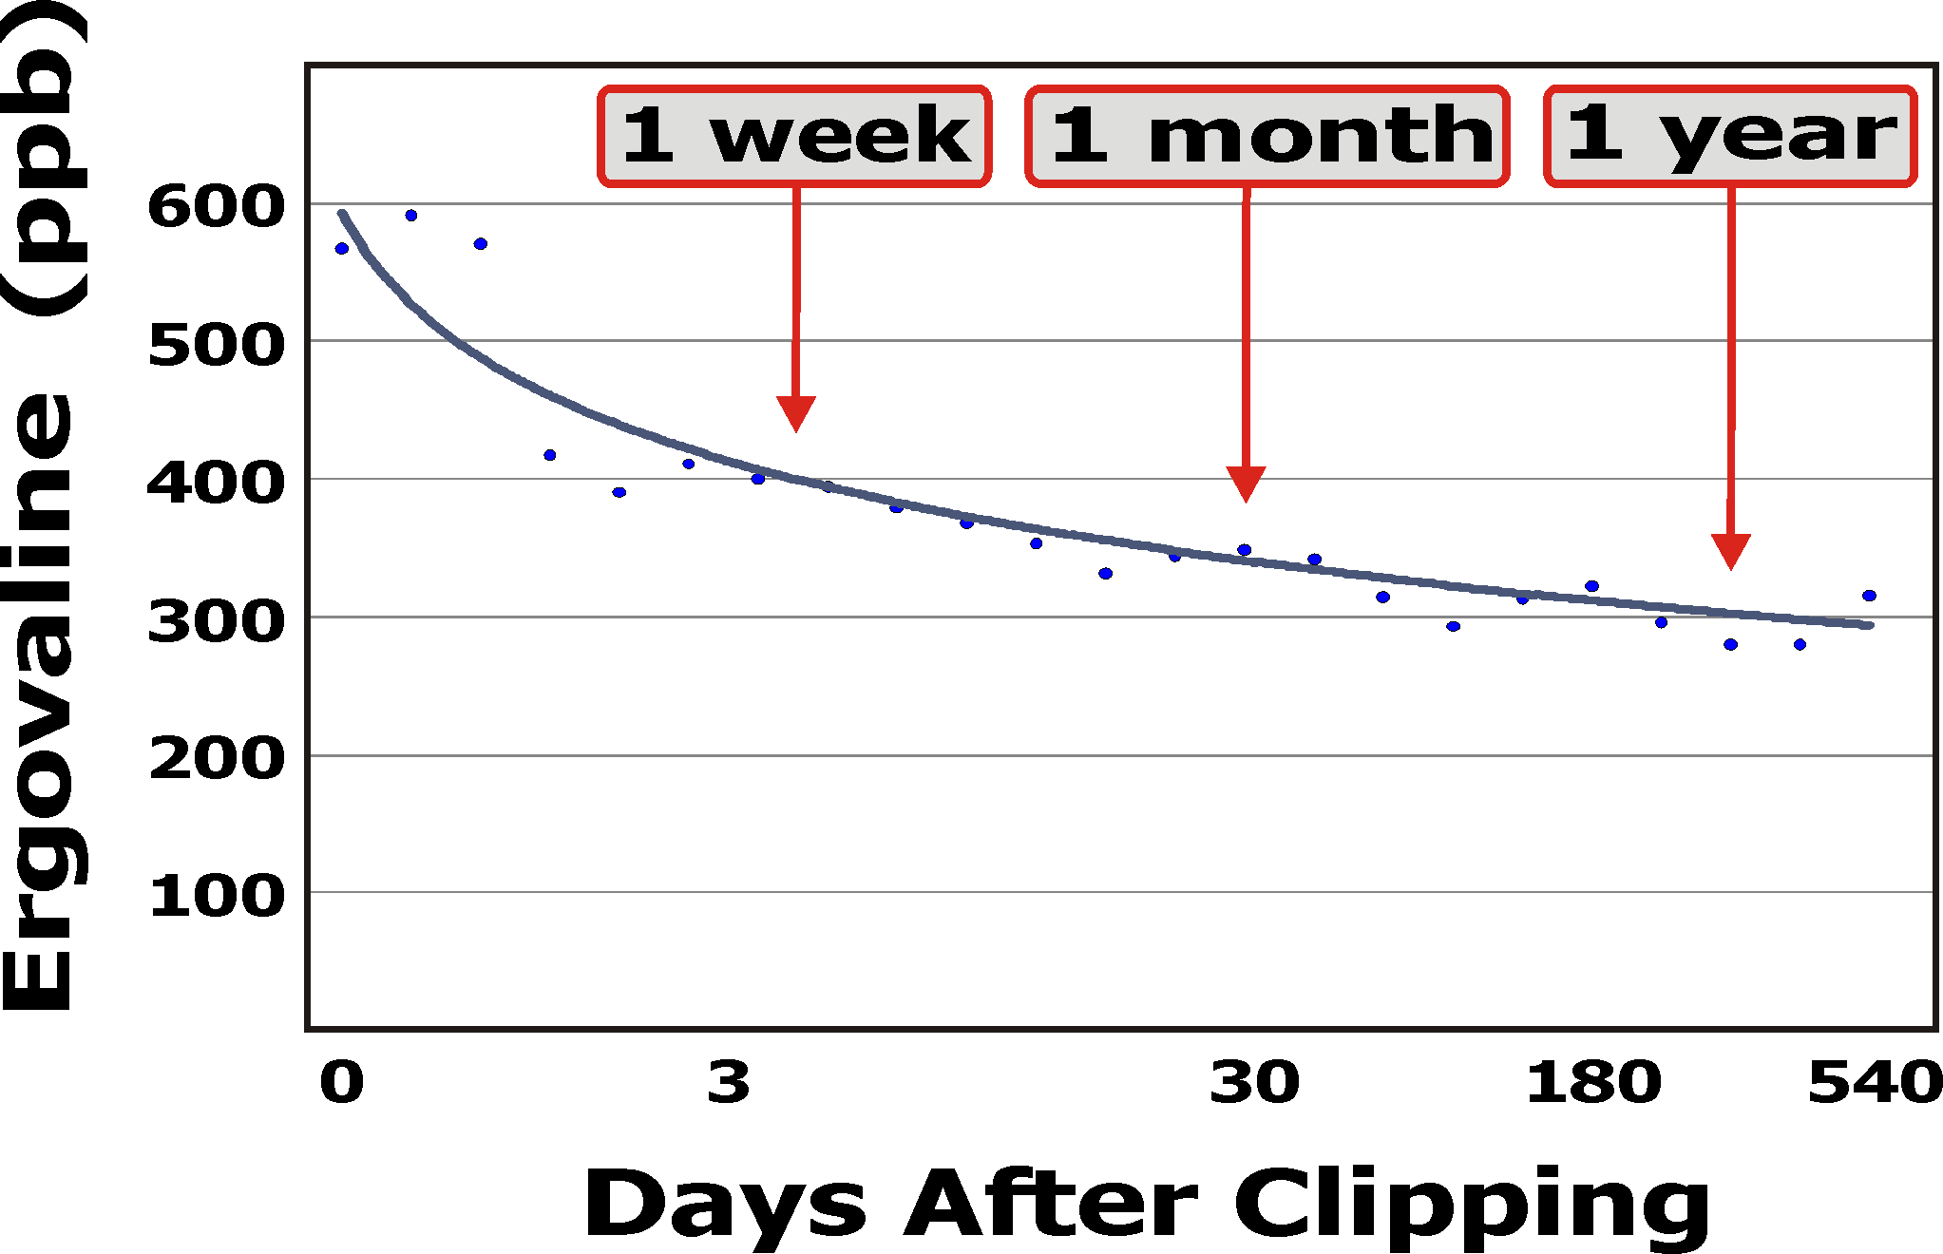
Ergovaline Content of Hay

Slide 8
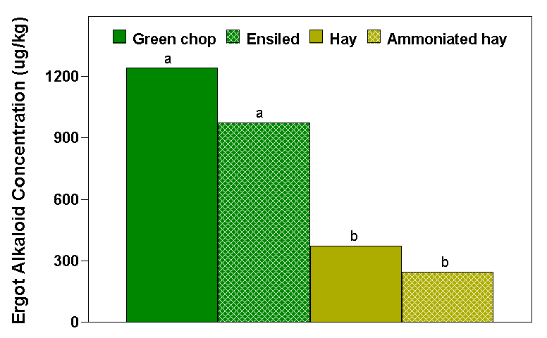
(Roberts et al, 2002)
Notes:
A VERY common question. How do you answer this?

Slide 9
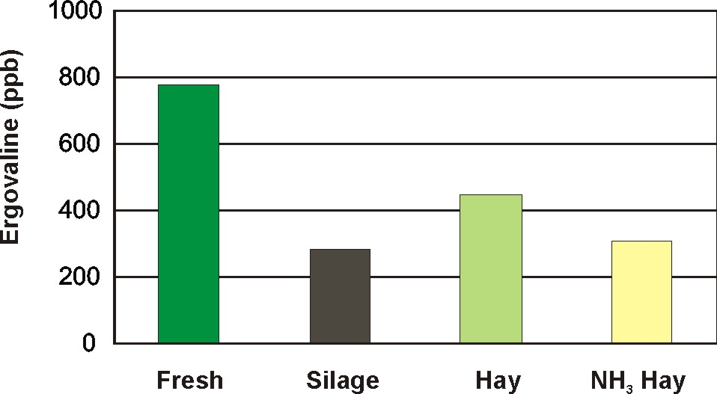
2004
(Roberts et al., in prep)
Notes:
A VERY common question. How do you answer this?

Slide 10
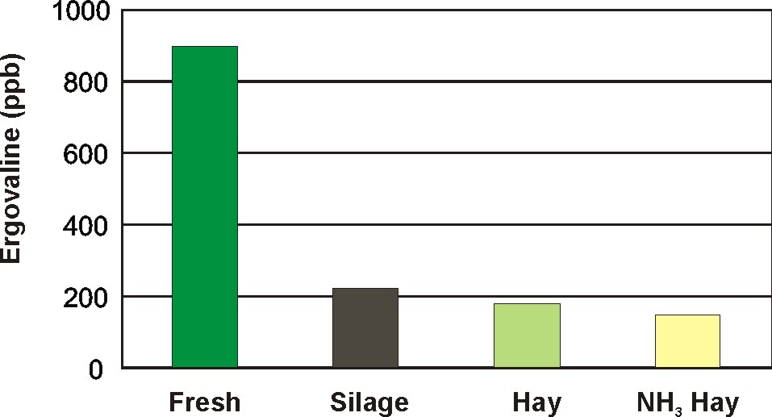
2005
(Roberts et al., in prep)
Notes:
A VERY common question. How do you answer this?

Slide 11
Fescue and the Endophyte
  Conclusions from MU Studies
Hay – 1/3 disappears in the first 2 weeks; ½ disappears after 6 months of storage
Silage – Variable results – Moisture levels can alter the results
  High Moisture (60%) – ergovaline disappears; total ergot alkaloids increases
  Low Moisture (43%) – Less abrupt changes

Slide 12
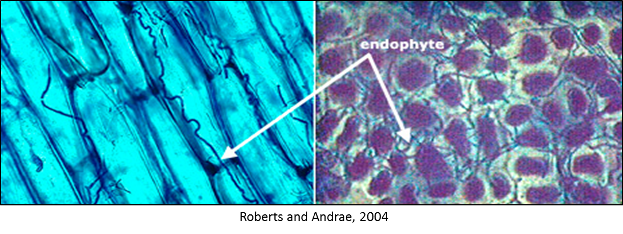
Consider Non-Toxic Fescue
 | AR4 | E- | E+
Location | Average Daily Gain (lb)
Fayetteville, AR | 1.43 | 1.55 | 0.93
Mt. Vernon, MO | 1.21 | 1.21 | 0.55
West et al., 1998

Slide 13
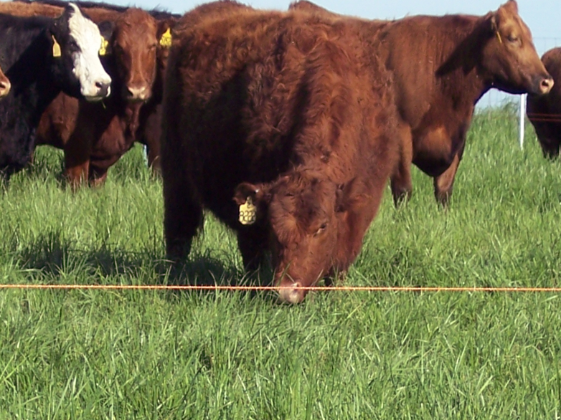
Non-Toxic Endophyte-Infected Fescue
Non-toxic endophytes (Novel or Friendly)
  Retain persistent qualities
  Animal performance similar to E-
Available Varieties:
  Jesup Tall Fescue with MaxQ
  Advance with AR37
  Bar-Optima with E34
  Texoma with MaxQII
  Estancia with ArkShield
  Duramax with Armor
  Others

Slide 14
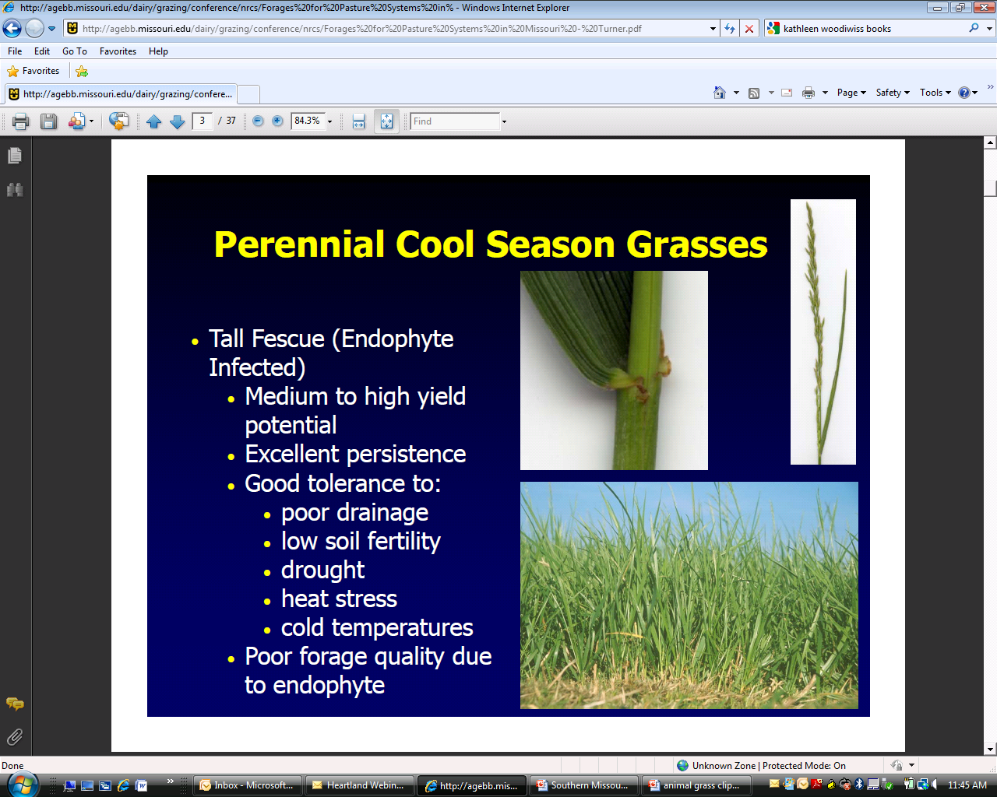
Tall Fescue
Early spring production
Medium to high yield potential
Excellent Persistence
Good Tolerance to:
  Poor Drainage
  Low Soil Fertility
  Drought
  Heat Stress
  Cold Temperatures
Poor forage quality due to the endophyte
Notes:
Round stem, short ligule, rough leaf margins

Slide 15
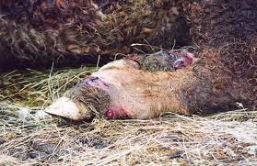
Problems with Toxic Endophyte Infected Tall Fescue
Lower conception rates
Reduced milk production
Reduced feed intake
Rough hair coat
Increased core body temperature in summer (leads to heat stress)
Frozen nose, ears, tails, etc (in winter)
Fescue foot

Slide 16
Novel Endophyte-Infected Fescue
Novel endophytes (“Friendly”) retains the good qualities of fescue
Available Varieties:
  MaxQ
  Advance
  Bar-Optima
  Others
 | AR4 | E- | E+
Location | Average Daily Gain (lb)
Fayetteville, AR | 1.43 | 1.55 | 0.93
Mt. Vernon, MO | 1.21 | 1.21 | 0.55
West et al., 1998

Slide 17
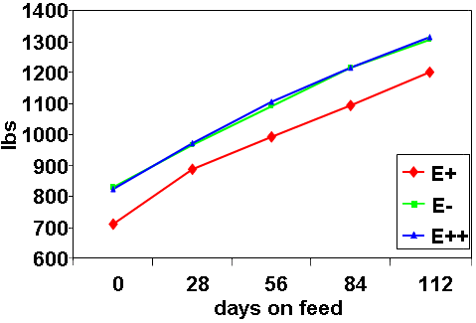
Novel Endophyte-Infected Fescue
Feedlot performance (lbs per animal) of beef cattle after grazing three types of tall fescue.
Cattle that previously grazed E- and E++ tall fescue entered the feedlot 117 pounds heavier finished 108 pounds heavier than cattle that grazed E+ tall fescue.
Roberts and Andrae, 2004

Slide 18
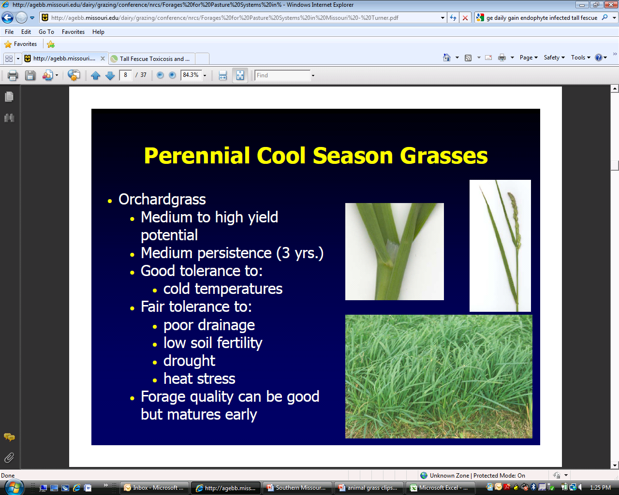
Orchardgrass
Medium to high yield potential
Medium persistence (3 years)
Tolerant of cold temperatures
Fair tolerance to:
  Poor drainiage
  Low soil fertility
  Drought
  Heat stress
Forage quality can be good but matures early
Notes:
Flat stem with white base, ligule membranous and pointed, leaves blue green in color
Low fall forage production.
Susceptible to overgrazing and disease.

Slide 19
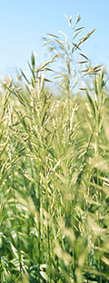
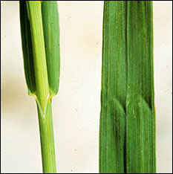
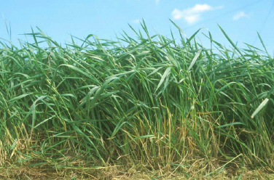
Smooth Bromegrass
Medium yield potential
Good persistence
Good tolerance to:
  Cold temperatures
  Drought
Fair tolerance to:
  Poor drainage
  Low soil fertility
  Heat stress
Forage quality good if managed

Slide 20
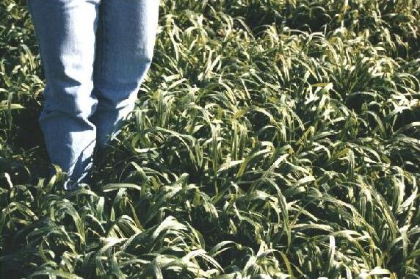
Matua
An improved brome
Grows earlier & later than brome
Excellent quality
Stays palatable in hot summer
Needs intensive management or will not persist!

Slide 21
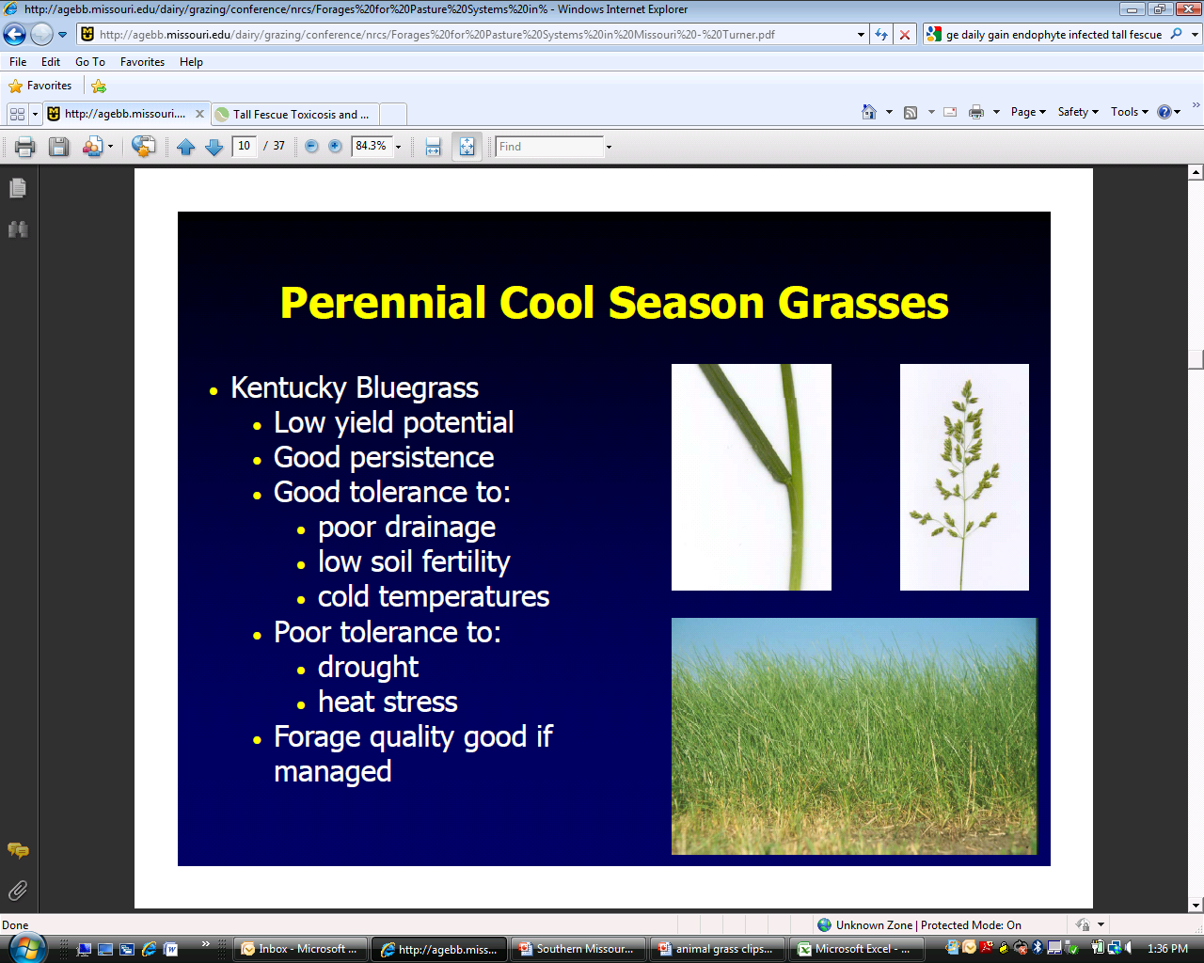
Kentucky Bluegrass
Low yield potential
Good persistence
Good tolerance to:
  Poor drainage
  Low soil fertility
  Cold temperatures
Poor tolerance to:
  Drought
  Heat Stress
Forage quality good if managed
Notes:
Stems are round to flat, very short membrane ligule, spreads by short rhizomes which can invade overgrazed pastures.

Slide 22
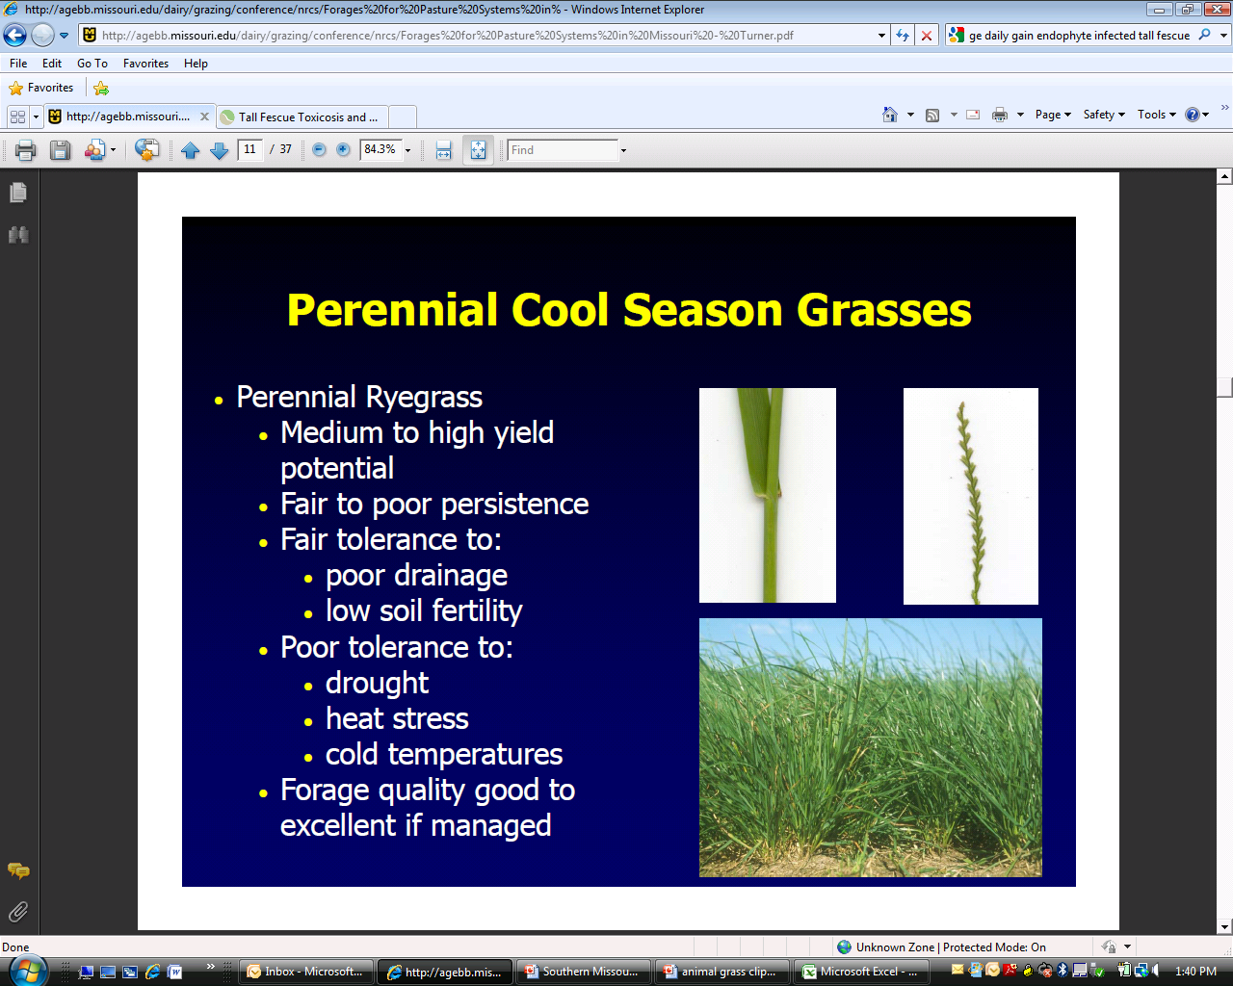
Perennial Ryegrass
Medium to high yield potential
Fair to poor persistence
Fair tolerance to:
Poor tolerance to:
Forage quality good to excellent if managed
Notes:
Shiney leaves, round stem, leaves emerge folded in a v-shape, membrane is short and toothed at top, inflorescence is spike placed with edge against stem

Slide 23
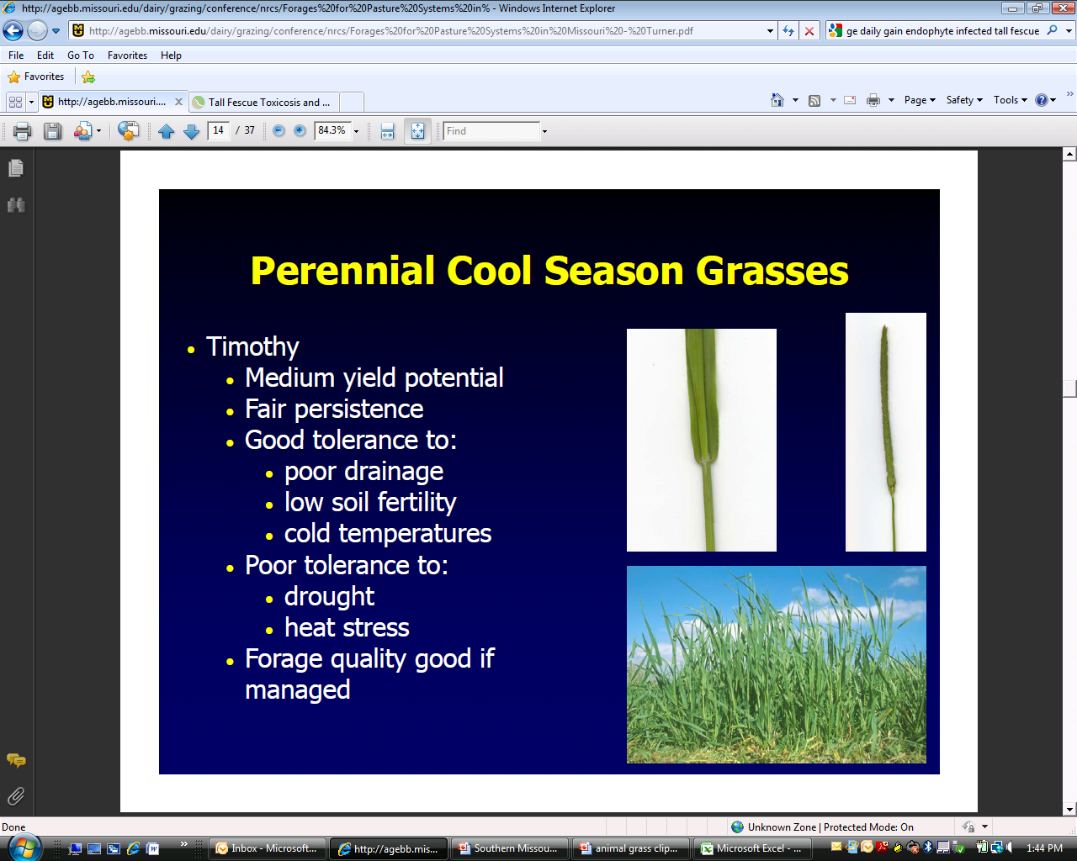
Timothy
Medium yield potential
Fair persistence
Good tolerance to:
  Poor drainage
  Low soil fertility
  Cold temperatures
Poor tolerance to:
  Drought
  Heat stress
Forage quality good if managed

Slide 24
Cool-season Grass with Legumes
Cool season
grass
Red Clover
White Clover
Alfalfa
Forage Yield
Annual Lespedeza
Feb
Apr
Jun
Aug
Oct
Dec

Slide 25
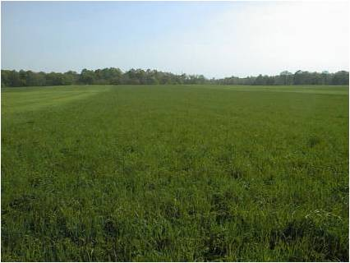
Alfalfa or Alfalfa/Grass
One of the best protein sources for livestock
Needs high fertility and management
Best for hay
Roundup Ready is back on the market

Slide 26
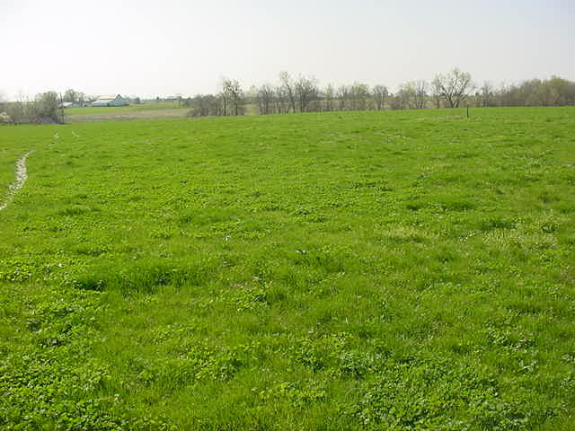
Benefits to Including Legumes
Improved forage quality
Fewer problems with fescue toxicosis
Improves animal gain
Minimizes the need for Nitrogen fertilizer
Longer grazing season

Slide 27
Steer Gains (ADG) on Fescue With and
Without Clover in the Stand
Multi-Year Tests on Four Research Farms in TN and GA

Slide 28
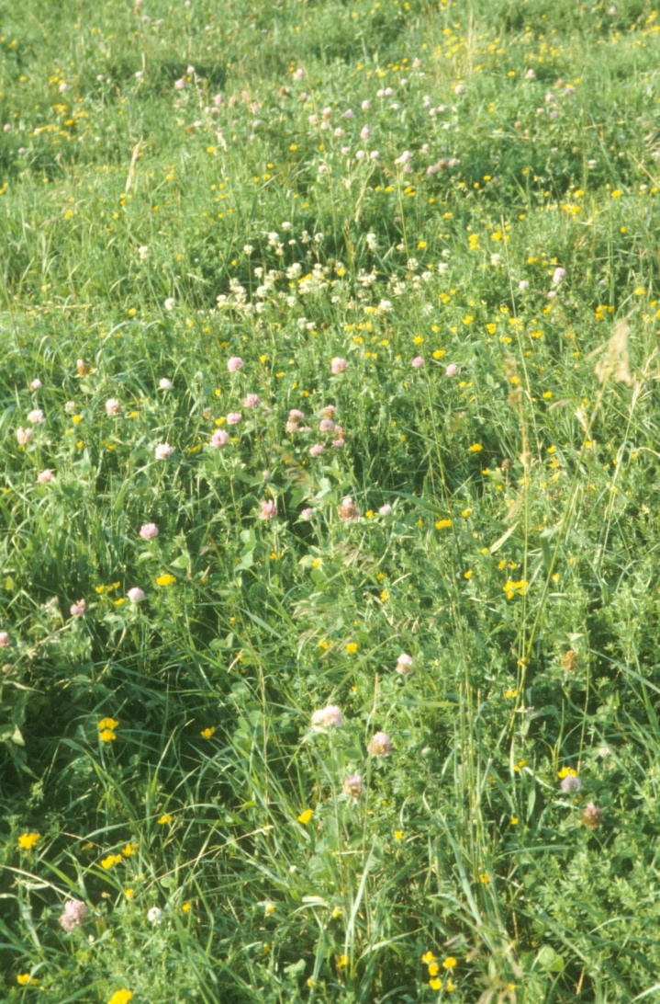
Overseeding Legumes
Conduct soil samples
  Legumes require higher fertility
Use inoculants
February seeding dates have a 50% better chance than April seeding dates

Slide 29
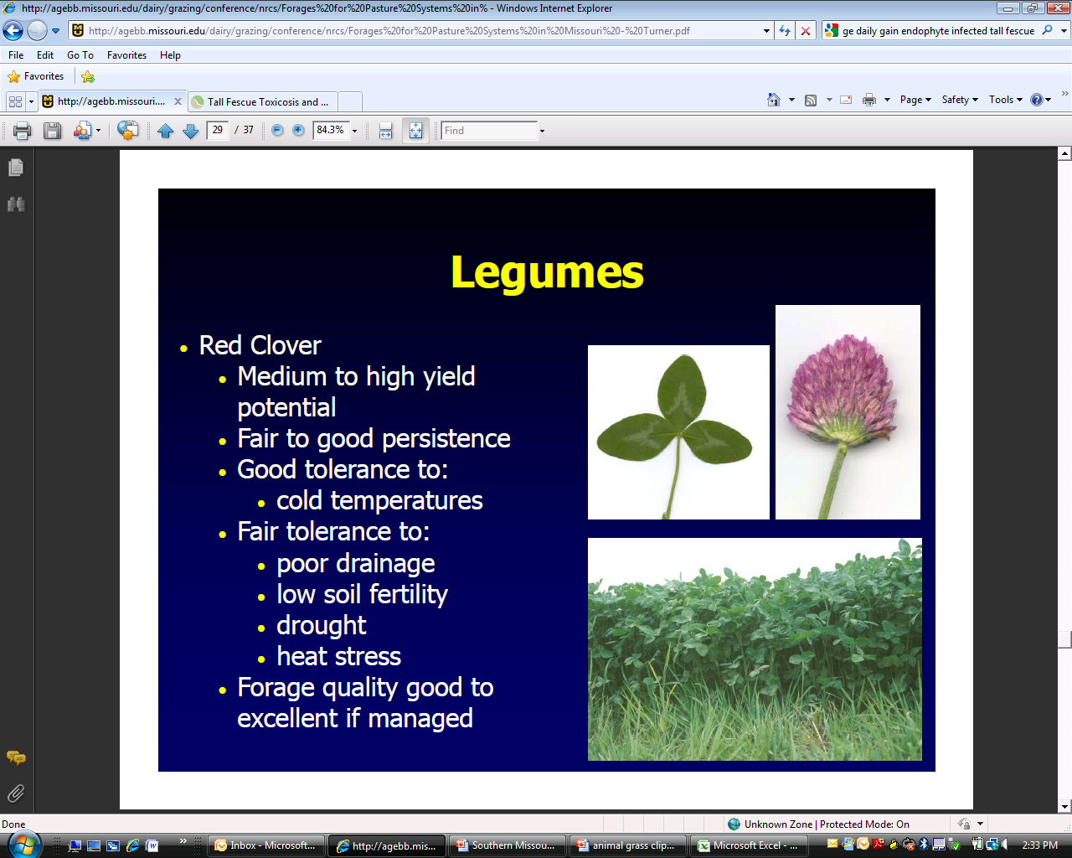
Red Clover
Medium to high yield potential
Fair to good persistence
Good tolerance to:
  Cold temperatures
Fair tolerance to:
  Poor drainage
  Low soil fertility
  Drought
  Heat stress
Forage quality good to excellent if managed

Slide 30
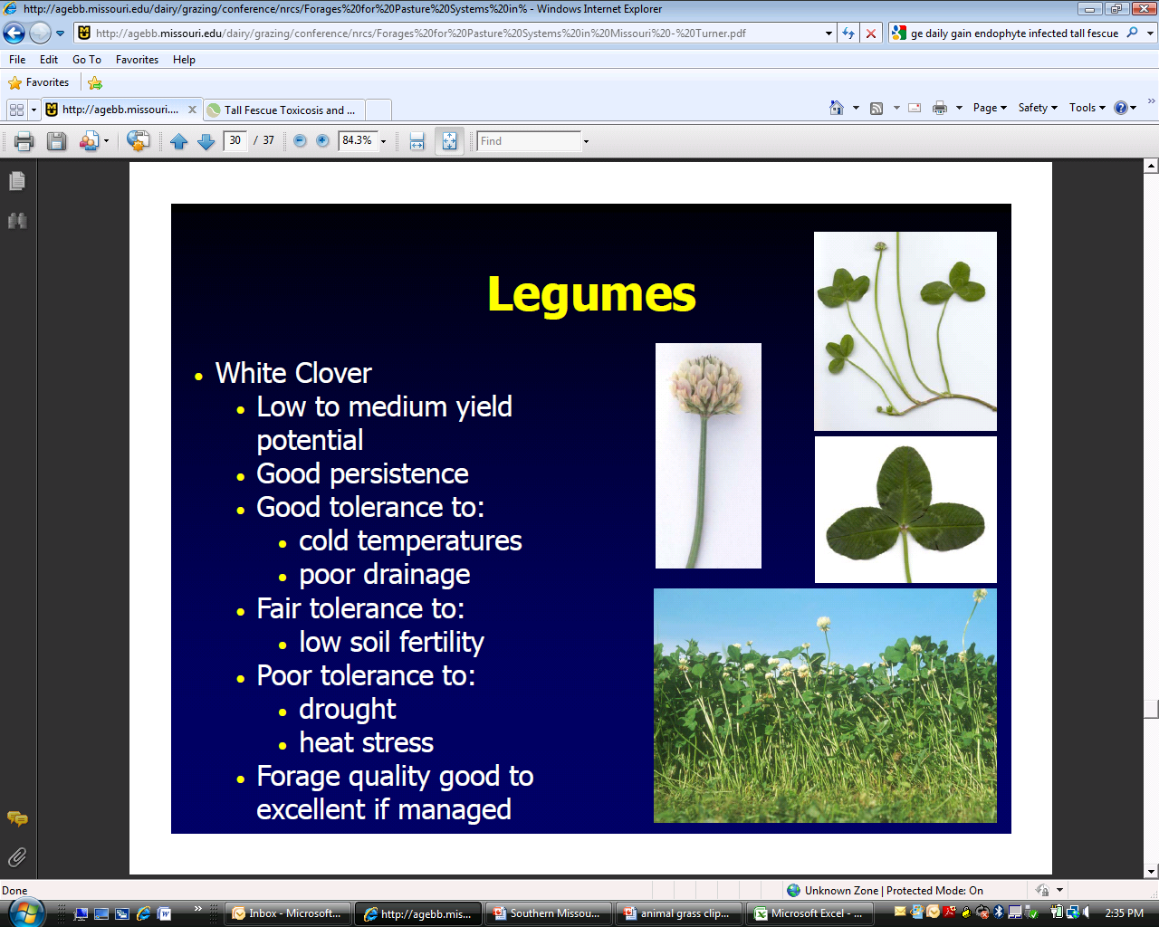
White (Ladino) Clover
Low to medium yield potential
Good persistence
Good tolerance to:
  Cold temperatures
  Poor drainage
Fair tolerance to:
  Low soil fertility
Poor tolerance to:
  Drought
  Heat stress
Forage quality good to excellent if managed

Slide 31
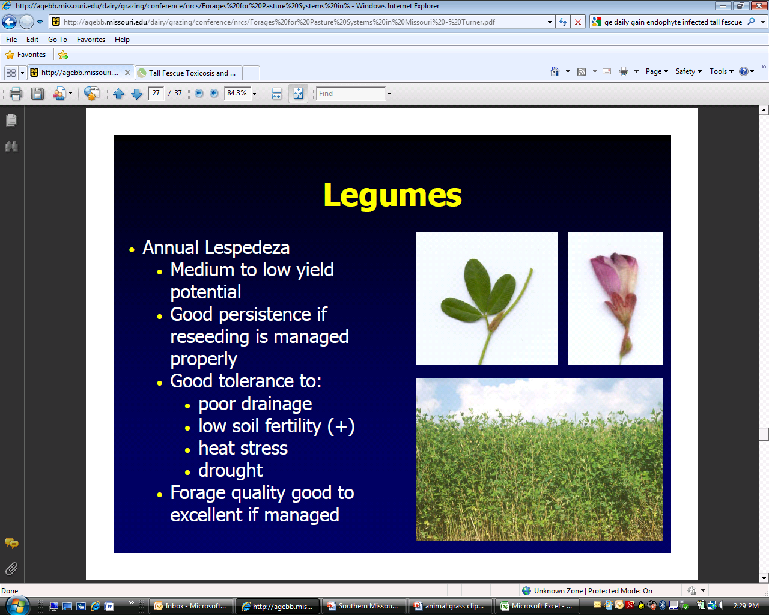
Annual Lespedeza
Medium to low yield potential
Good persistence if reseeding is managed properly
Good tolerance to:
  Poor drainage
  Low soil fertility
  Heat stress
  Drought
Forage quality good to excellent if managed

Slide 32
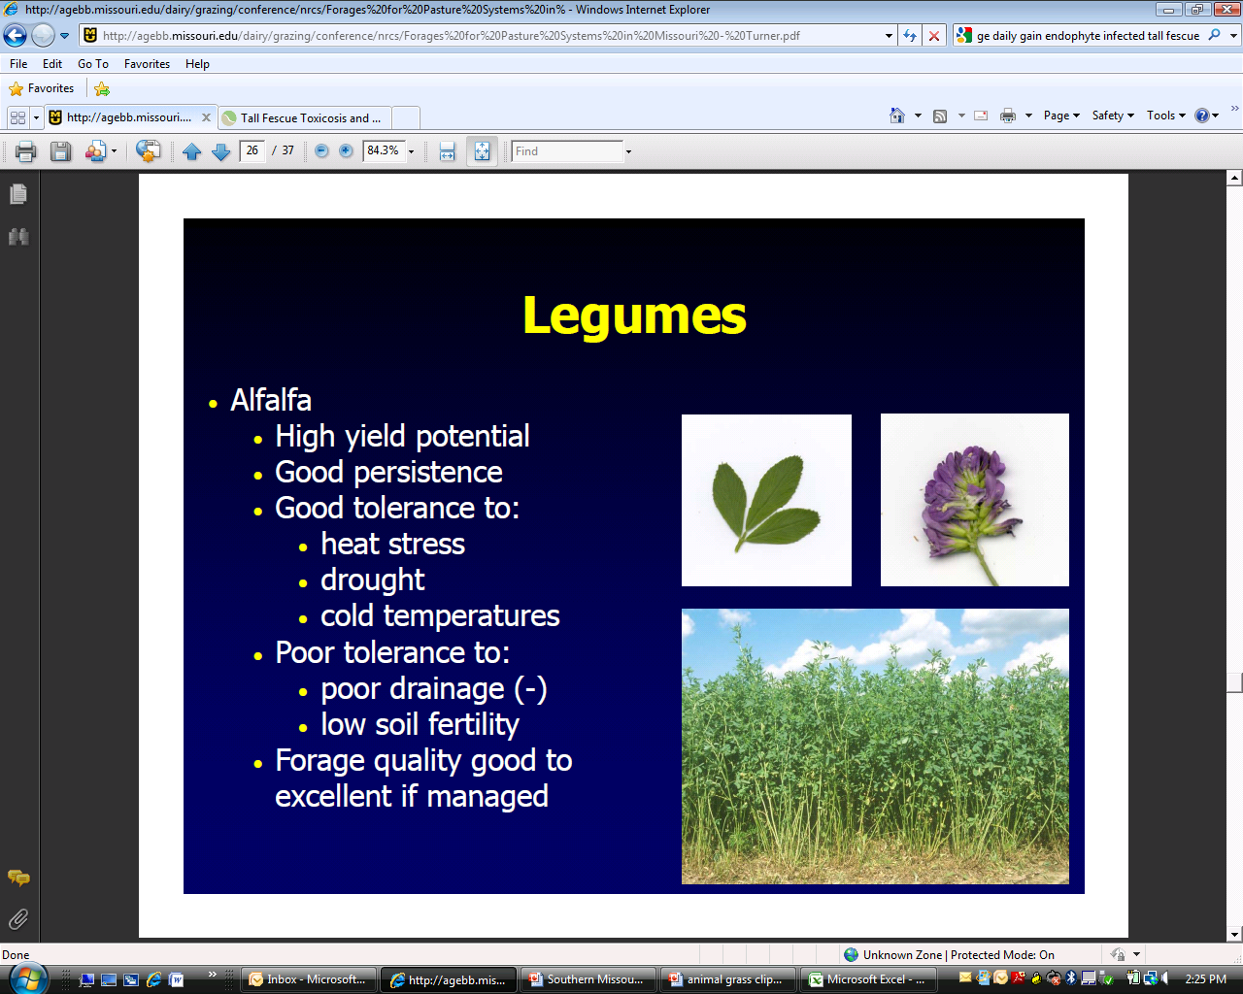
Alfalfa
High yield potential
Good persistence
Good tolerance to:
  Heat stress
  Drought
  Cold temperatures
Poor tolerance to:
  Poor drainage
  Low soil fertility
Forage quality good to excellent if managed

Slide 33
Perennial Warm-Season Grasses
Caucasian
bluestem
Bermudagrass
Cool season
grass
Forage Yield
Feb
Apr
Jun
Aug
Oct
Dec

Slide 34
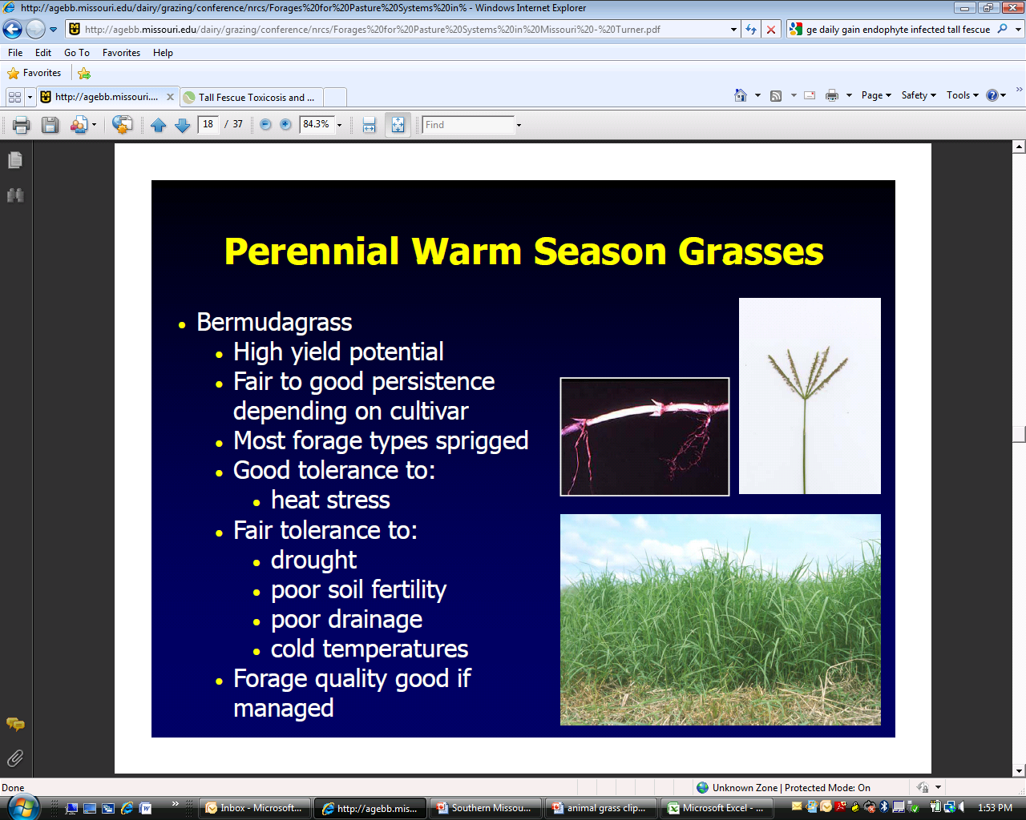
Bermudagrass
High yield potential
Fair to good persistence depending on cultivar
Good tolerance to heat stress
Fair tolerance to:
  Drought
  Poor soil fertility
  Poor drainage
  Cold temperatures
Forage quality good if managed
Notes:
Spreads by both stolons and rhizomes, hairs found on top and bottom of leaf blade, ligule is a fringe of hairs.

Slide 35
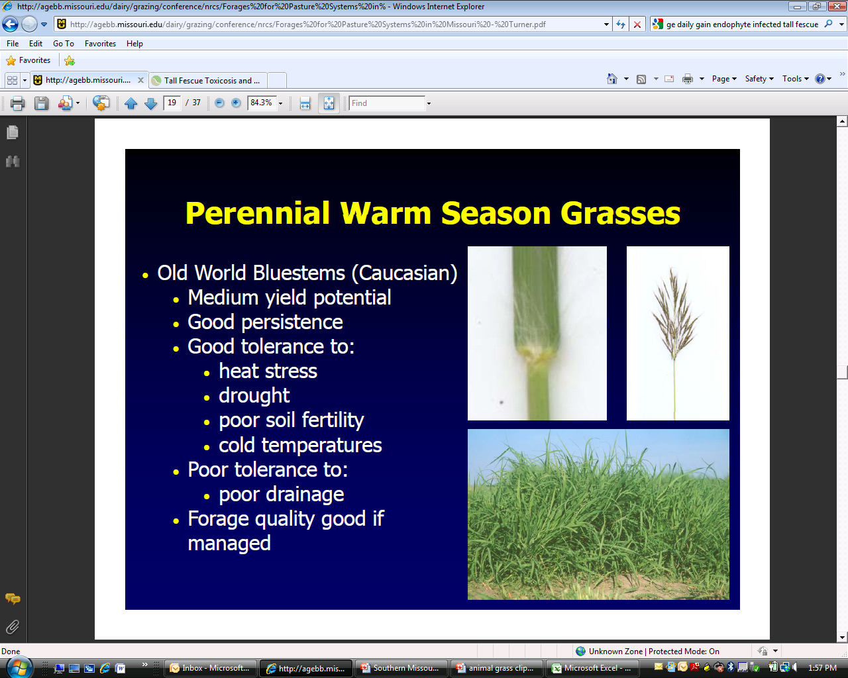
Caucasian (Old World) Bluestem
Medium yield potential
Good persistence
Good tolerance to:
  Heat stress
  Drought
  Poor soil fertility
  Cold temperatures
Poor tolerance to:
  Poor Drainage
Forage quality good if managed
Notes:
Animal ADG for caucasian bluestem was lower when compared to switchgrass. But animals were able to graze 40 days longer (MU Southwest Research center).

Slide 36
Annual Warm-Season Grasses
Sudangrass
Cool Season
Grass
Pearl Millet
Teff
Forage Yield
Crabgrass
Feb
Apr
Jun
Aug
Oct
Dec

Slide 37
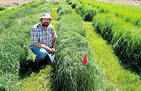
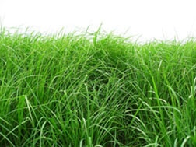
Teff
High quality forage
Lower yielding than other WSG annuals
Some grazing concerns

Slide 38
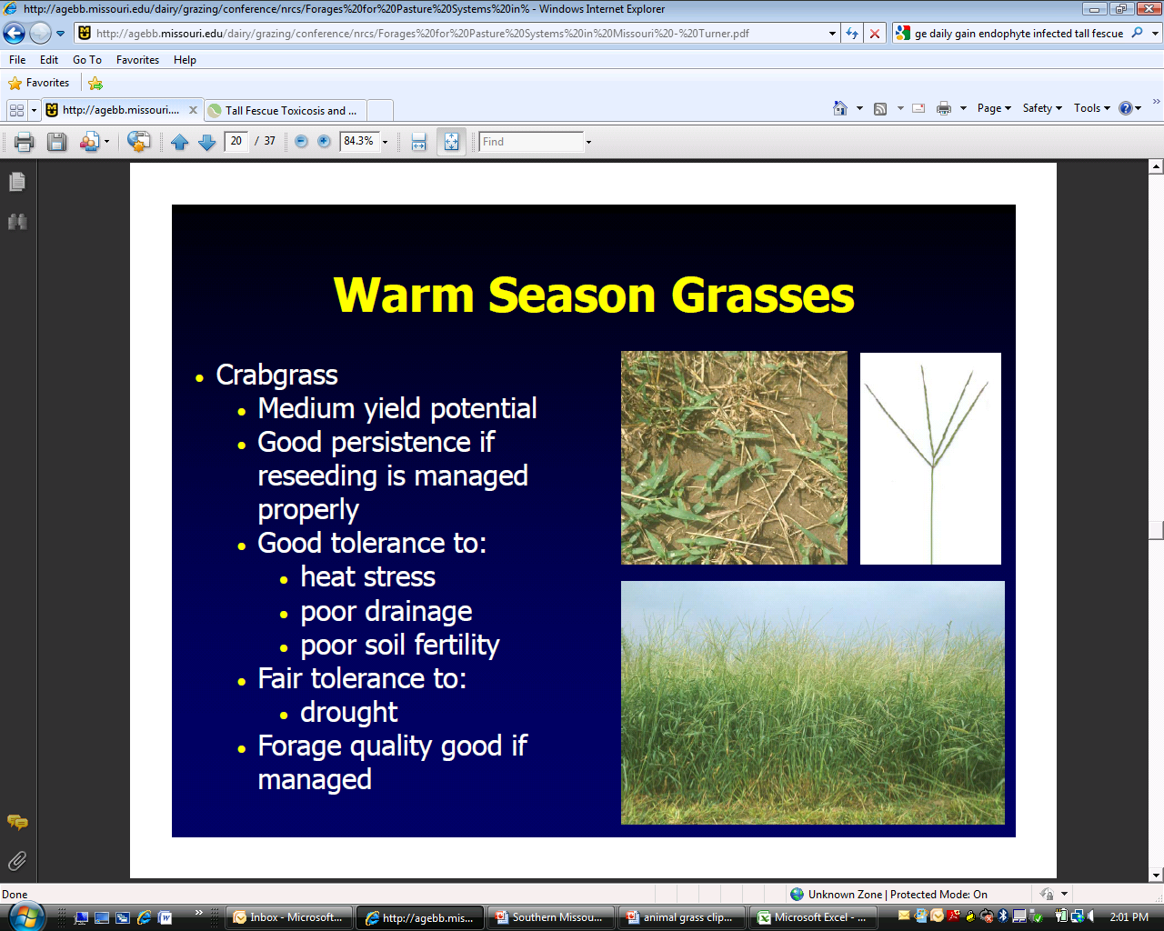
Crabgrass
Medium yield potential
Good persistence if reseeding is managed properly
Good tolerance to:
  Heat stress
  Poor drainage
  Poor soil fertility
Fair tolerance to:
  Drought
Forage quality good if managed
Notes:
NO hairs of leaf

Slide 39
Native Warm-Season Grasses
Switchgrass
Indiangrass
Cool Season
Grass
Big Bluestem
Eastern
Gamagrass
Forage Yield
Feb
Apr
Jun
Aug
Oct
Dec
Notes:
Native warm-season grasses can also fill the summer gap. Research at the University of Missouri Southwest Center showed that steers grazing eastern gamagrass gained as much as steers grazing alfalfa; however, they did not graze as long. The reason is seen in this slide; eastern gamagrass (as well as switchgrass) does not produce the high yield of alfalfa during late summer and early fall.

Slide 40
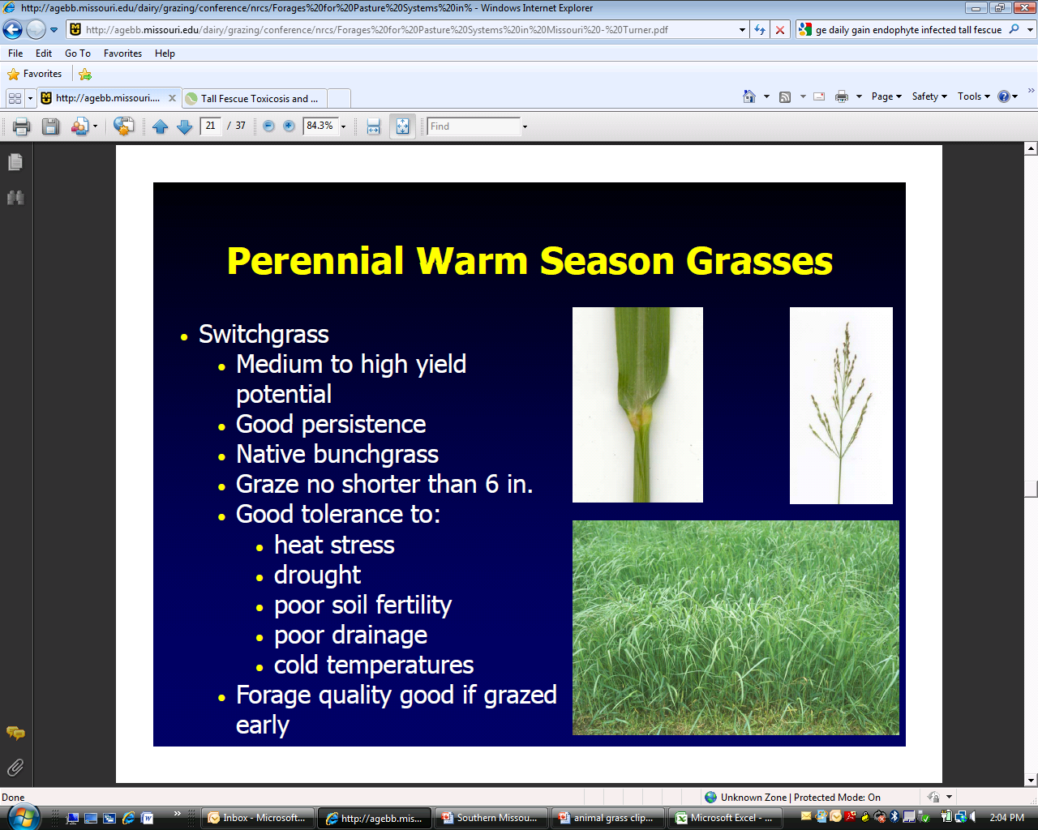
Switchgrass
Medium to high yield potential
Good persistence
Graze no shorter than 6”
Graze 2-3 weeks earlier than Big Bluestem
  Often ready for grazing before the cool season grasses have stopped producing.
Adapts well to wetter sites
Aggressive - Competitive
Forage quality good if grazed early
Varieties: Cave-In-Rock; Kanlow; Alamo; Blackwell
Notes:
Round base white to purplish tinged below, fringe of hairs with a dense mat of hairs extending onto the upper leaf surface, sod forming

Slide 41
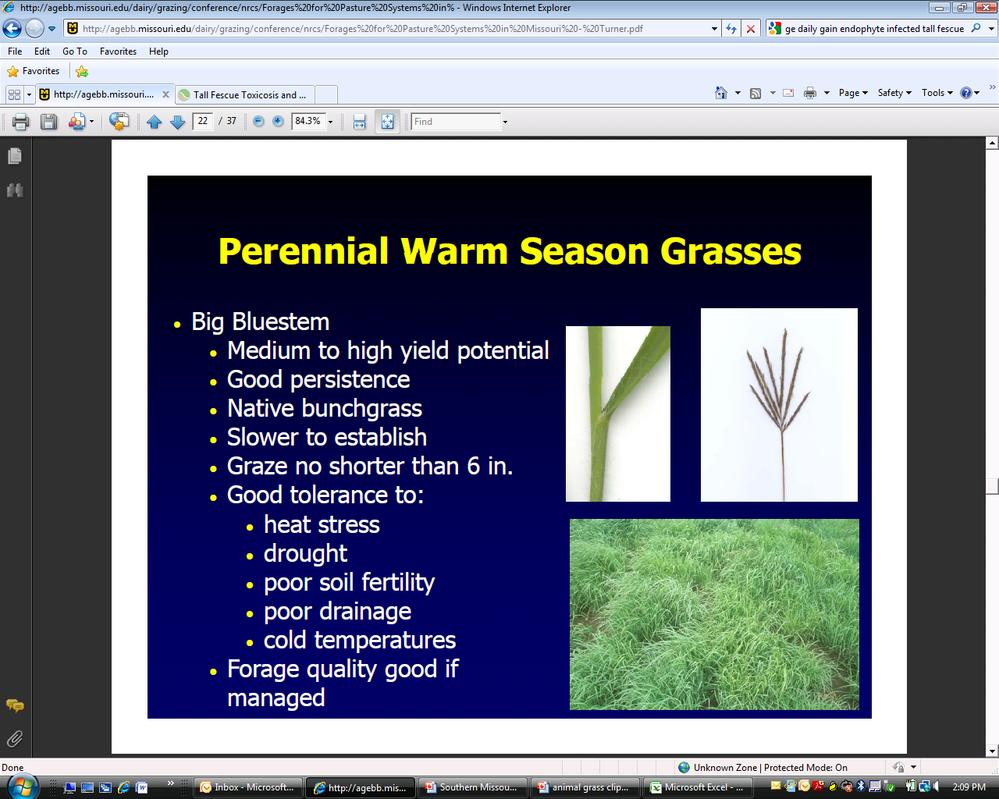
Big Bluestem
Medium to high yield potential
Good persistence
Slow to establish
  More difficult to establish than switchgrass
Graze no shorter than 6”
Drought tolerant
Forage quality good if managed
Varieties: Bonanza; Goldmine; Rountree; Kaw; Oz 70
Notes:
Round purple base, usually hairy, long hairs on upper leaf surface needs moderately well drained soil, medium to low fertility

Slide 42
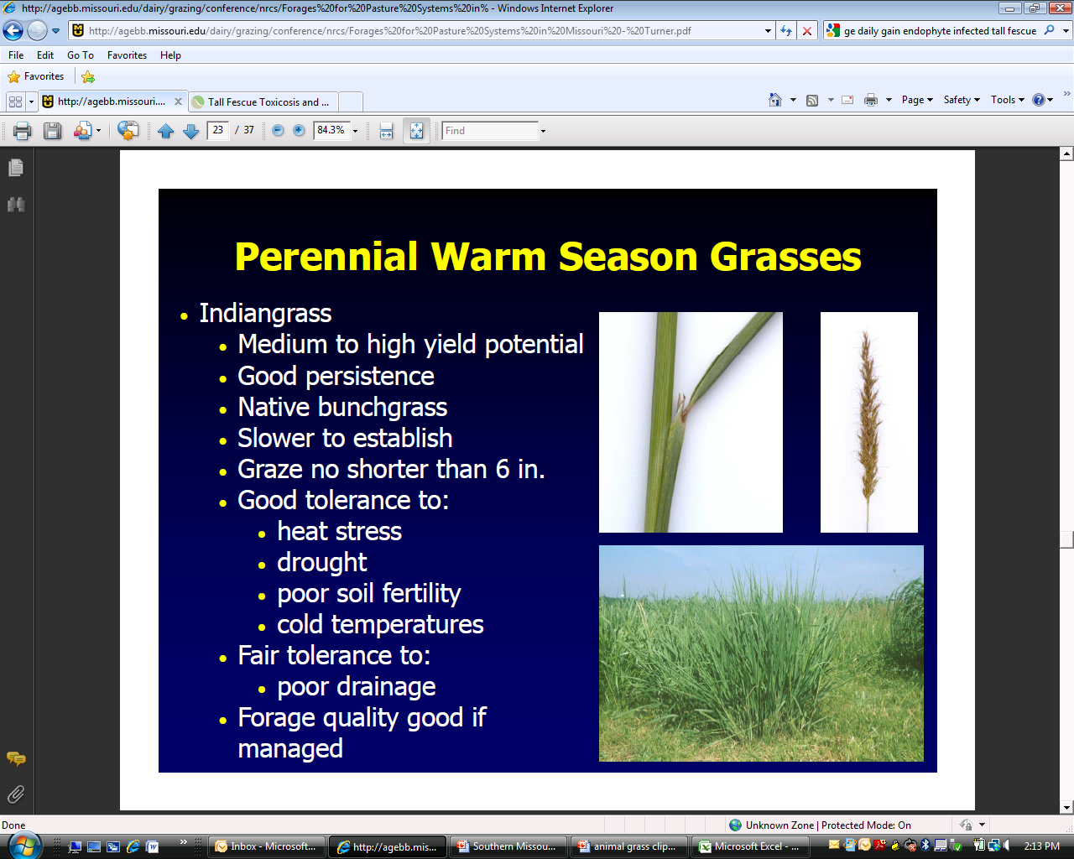
Indiangrass
Medium to high yield potential
A late producer
  1-2 weeks later than Big Bluestem
Good persistence
Slow to establish
Graze no shorter than 6”
Good tolerance to:
  Drought
  Poor soil fertility
Fair tolerance to:
  Poor drainage
Forage quality good if managed
Varieties: Rumsey; Cheyenne
Notes:
Round base may be hairy. Prominent membranous ligule

Slide 43
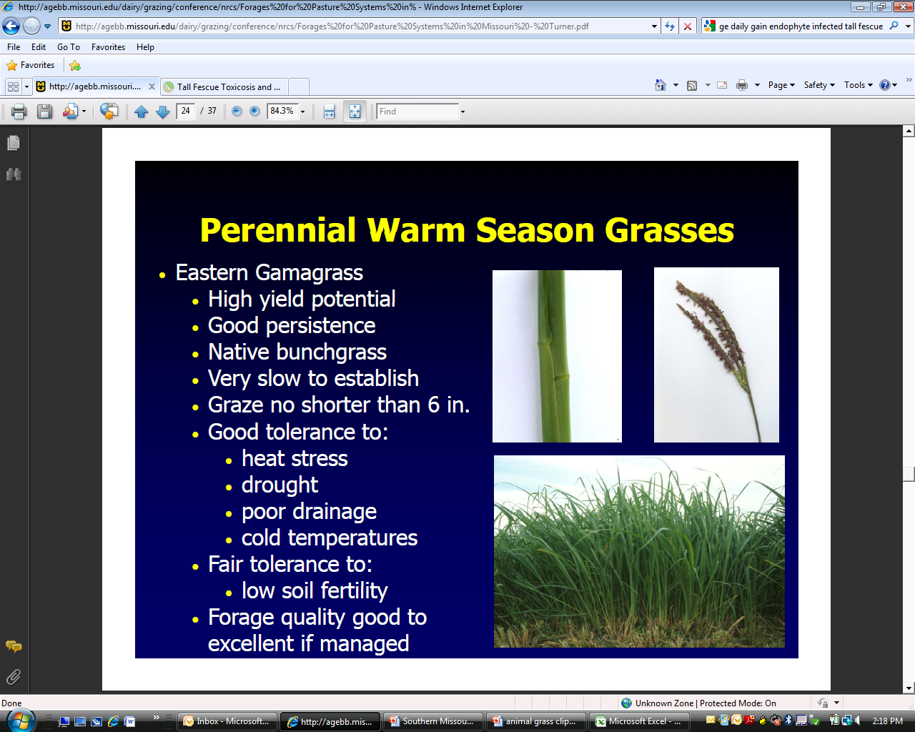
Eastern Gamagrass
High yield potential
  Approximately 2 inches per day
  6.5 tons per acre measured in Missouri
Good persistence
Very slow to establish
Graze no shorter than 6”
Good tolerance to:
  Drought
  Poor drainage
Fair tolerance to:
  Low soil fertility
One of the most palatable native warm-season grasses
  SW Center dairy heifer gain data:
    Gama = 2.1 lb/day
    Alfagraze = 2.3 lb/day

Slide 44
Milk Production from Bermudagrass vs. CSG Pasture in Summer
Forage Type | Milk Yield (lb/d)
Bermudagrass | 47.0
CSG Mix | 41.3

Slide 45
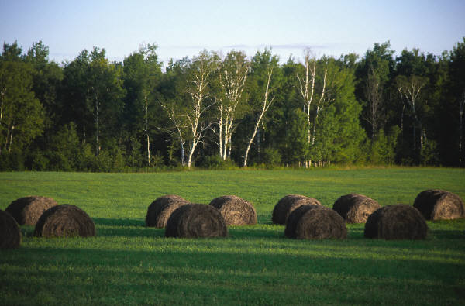
How Do I Grow High Quality Hay?

Slide 46
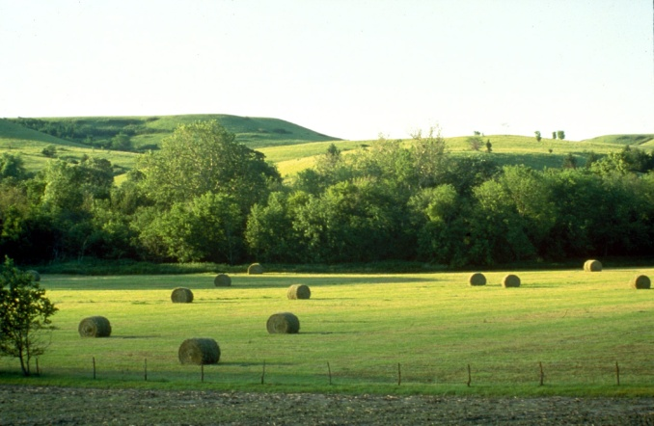
50% May Never Make It Through a Cow

Slide 47
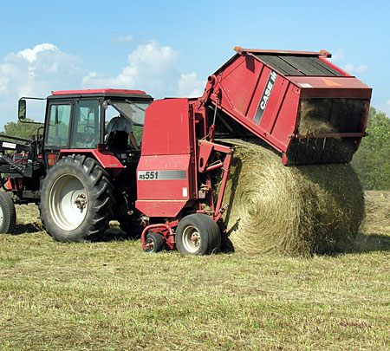
Hay Quality Factors
Forage Species
Curing and Handling Conditions
Stage of Maturity

Slide 48
Forage Species
Yield, crude protein (CP), and total digestible nutrients (TDN) contents of various hay crops.
Forage Species | Yield (ton/Acre) | CP (%) | TDN (%)
Alfalfa | 3-6 | 17-22 | 57-62
Orchardgrass | 2-5 | 12-15 | 55-60
Tall Fescue | 2-4 | 10-15 | 55-60
Rye | 1-4 | 8-10 | 50-55
Ryegrass | 1-4 | 10-16 | 56-62
Bermudagrass | 5-8 | 10-14 | 52-58
Johnsongrass | 2-5 | 10-14 | 50-60
Pearl Millet | 2-6 | 8-12 | 50-58
Values are expressed on a dry matter basis.
Adapted from: D.M. Ball et. al. 2008. Southern Forages
Notes:
Legumes are higher quality than grasses
Cool-season grasses are higher quality than warm-season grasses
Within each class there is a wide range in quality

Slide 49
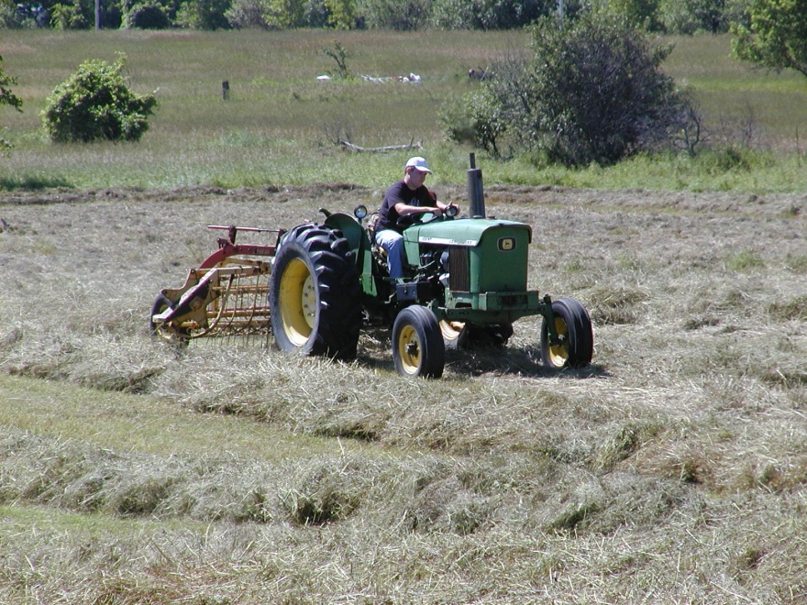
Curing and Handling Conditions
Poor weather and handling conditions can lower hay quality
  Rain can cause leaf loss and nutrient leaching from plants
  Sunlight can reduce Vitamin A by bleaching
  Raking dry, brittle hay can cause excessive leaf loss

Slide 50
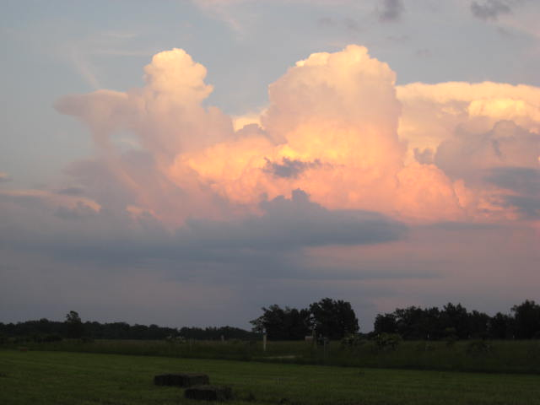
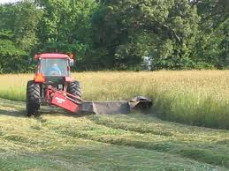
Missouri’s Hay Dilemma

Slide 51
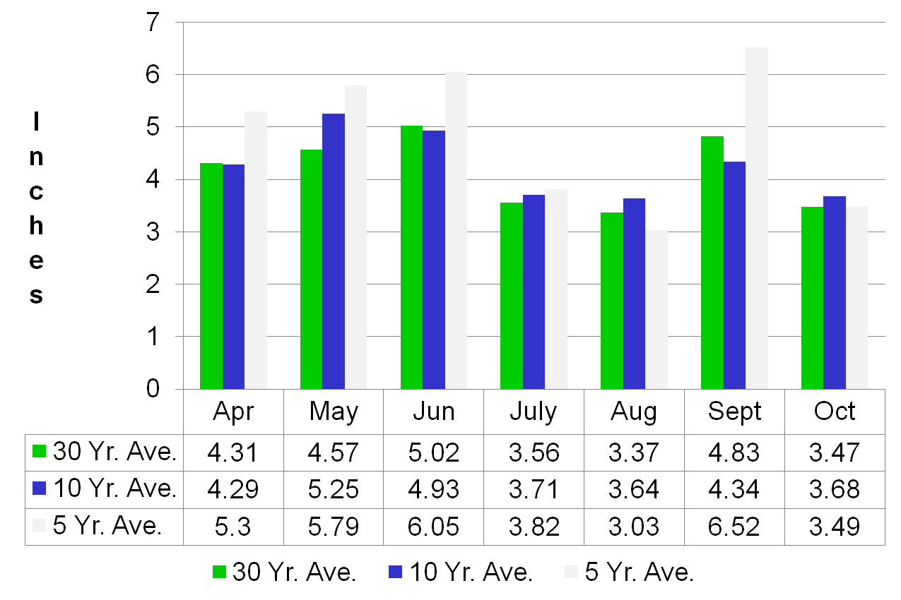
Springfield Precipitation Records

Slide 52
Springfield Precipitation Record - Inches
 | Apr | May | Jun | Jul | Aug | Sept | Oct
2007 | 4.04 | 4.07 | 8.11 | 2.80 | 4.34 | 4.93 | 1.88
2008 | 4.74 | 5.20 | 13.41 | 2.66 | 0.60 | 8.15 | 2.38
2009 | 8.26 | 5.52 | 4.61 | 3.70 | 4.51 | 5.63 | 9.97
2010 | 3.99 | 7.14 | 2.33 | 6.37 | 1.53 | 11.65 | 1.01
2011 | 7.89 | 5.92 | 0.82 | 1.71 | 2.88 | 4.05 | 1.28
Average | 5.78 | 5.57 | 5.86 | 3.45 | 2.77 | 6.88 | 3.39

Slide 53
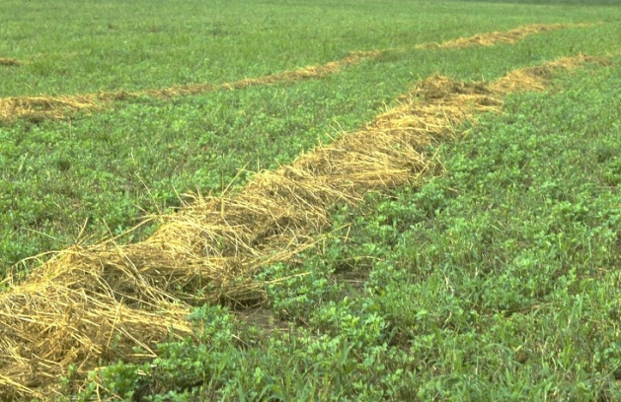
Second Cutting Alfalfa-Grass Farmer Survey
 | % CP | %ADF | %NDF | %TDN
Rain-Free Hay | 16.7 | 42.2 | 52.4 | 54.4
Rained On Hay | 13.7 | 46.2 | 62.0 | 49.8
Source: Ann Cowen, Iowa State Univ.

Slide 54
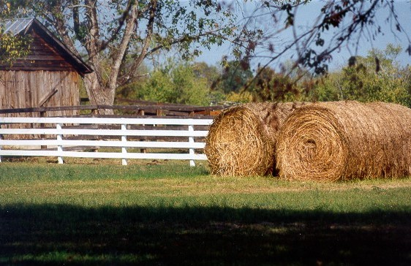
Strategies for Missouri’s
Hay Dilemma
Keep doing what we’ve always done

Slide 55
Curing and Handling Conditions
The timing of when rainfall occurs after cutting will influence quality
  Immediately after cutting
    Plant cells are still turgid so little moisture enters the cells and leaches the water-soluble cell contents
    some loss does occur, but is minimal
  After the hay has dried a while
    plant cells will re-absorb moisture and greater leaching of cell contents will occur
    drying will make plants somewhat brittle -- if hard pounding rains occur, leaves can be broken off, which will also lead to dry matter losses and lower quality

Slide 56
Strategies for Missouri’s
Hay Dilemma
Keep doing what we’ve always done
Baleage

Slide 57
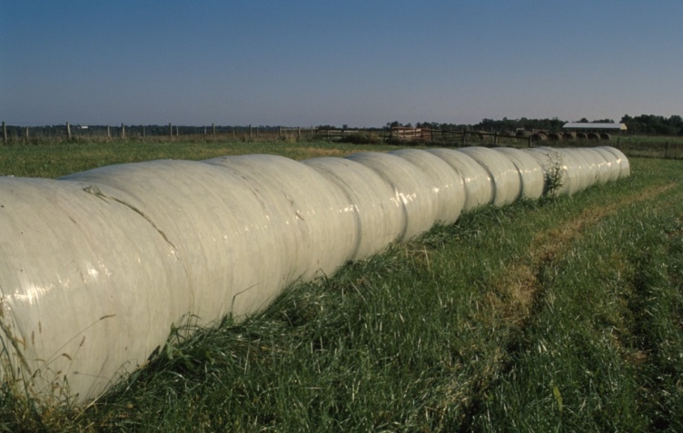
Baleage

Slide 58
Strategies for Missouri’s
Hay Dilemma
Keep doing what we’ve always done
Baleage
April Harvest

Slide 59
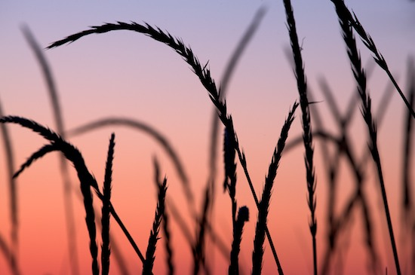
April Harvest
Lower yield
Higher quality 1st and 2nd cutting
If too early, seedheads may still emerge

Slide 60
Strategies for Missouri’s
Hay Dilemma
Keep doing what we’ve always done
Baleage
April Harvest
Late Grazing

Slide 61
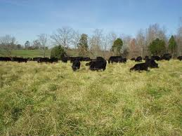
Late Grazing of Hay Fields
March-Early April
Late Cutting (June/July)
Keeps in vegetative state into a drier season

Slide 62
Strategies for Missouri’s
Hay Dilemma
Keep doing what we’ve always done
Baleage
April Harvest
Late Grazing
Warm Season Forages

Slide 63
Springfield Precipitation Records

Slide 64

Hay Production Alternatives
Native Warm Season Grasses
  Switchgrass
  Big Bluestem
Introduced Species
  Bermudagrass
  Crabgrass
  Caucasian Bluestem
Native Warm Season Grass
Notes:
This Georgia research is one example showing how early season nitrogen increases fescue yield (green segments). Note that spring fertilizer had no effect on yield in summer and fall. Also note that even when nitrogen was applied in fall the greatest yield was in spring.

Slide 65

Curing and Handling Conditions
Hay should be baled at moistures ranging between15 to 20 %
Bales packaged at greater than 20 percent moisture levels are at greater risk for mold, which leads to animal refusal and increased dry matter losses.

Slide 66

Curing and Handling Conditions
Crushing stems (conditioning) at the time of mowing will decrease the drying time of large-stemmed plants (by approximately 1 day) and results in less leaf and nutrient loss
Raking hay while it is moist, 40% moisture, and baling before hay is crisp, 18% moisture, will help reduce leaf loss

Slide 67

Time of Day for Cutting
TNC = Total Nonstructural Carbohydrates Burns, et al. 2007 Crop Science, 47:2190-2197

Slide 68

Time of Day for Cutting
TNC = Total Nonstructural Carbohydrates Fisher, et al. 2002 Crop Science, 42:231-237

Slide 69

Stage of Maturity
Within each forage species, the most important factor affecting hay quality is stage of maturity.

Slide 70

Stage of Maturity
Notes:
As grasses and legumes advance from the vegetative to the reproductive (seed) phase, they become higher in fiber and lower in protein, digestibility and palatability. Forage quality deteriorates rapildly as the forages matures even though yeild continues to increase.

Slide 71

Stage of Maturity
Notes:
As grasses and legumes advance from the vegetative to the reproductive (seed) phase, they become higher in fiber and lower in protein, digestibility and palatability. Forage quality deteriorates rapildly as the forages matures even though yeild continues to increase.

Slide 72


Slide 73

Stage of Maturity
Clover/Alfalfa
  1/3 Bloom
Grasses
  Boot Stage

Slide 74
Stage of Maturity
What is the boot stage?
  This is the stage just prior to heading out.
  The flag leaf is fully expanded, but the seed head is not visible.
  The seed head can be felt in the flag leaf sheath.
Each plants ultimate goal is survival, which is dependent on seed production
Fall production does not contain reproductive structures

Slide 75


Stage of Maturity
What is the boot stage?

Slide 76
Stage of Maturity
The effect of stage of maturity at harvest on alfalfa hay quality.
Stage at Harvest | CP (%) | Acid Detergent Fiber (%) | Digestibility (%)
Pre-bloom | 21.1 | 30.2 | 63.3
Early bloom | 18.9 | 33.0 | 62.4
Mid-bloom | 14.7 | 38.0 | 55.4
Full bloom | 16.3 | 45.9 | 53.2
Values are expressed on a dry matter basis. From: Kawas et. al. 1990. Journal of Animal Science. 68:4376.

Slide 77
Stage of Maturity
The effect of age on Tifton-44 bermudagrass hay on yield and quality.
Cutting Interval | Yield (lb DM/Acre) | CP (%) | Digestibility (%)
1 Week | 8539 | 19.8 | 61.8
2 Weeks | 8603 | 17.0 | 62.2
4 Weeks | 8197 | 14.1 | 61.3
8 Weeks | 13329 | 9.7 | 54.3
Values are expressed on a dry matter basis. From: Mason and Burton. 1982. Agronomy Journal. 74.371

Slide 78
Stage of Maturity
The effect of stage of maturity at harvest on timothy hay quality, animal intake, and milk yield.
Stage at Harvest | CP (%) | Acid Detergent Fiber (%) | Intake (lb DM/day) | Intake (% body wt) | Milk (lb/day)
Late Boot | 11.3 | 35.9 | 33.3 | 2.84 | 37.5
Late Bloom | 5.4 | 42.1 | 24.3 | 2.17 | 20.1
Values are expressed on a dry matter basis. From: Vinet et. al. 1980. Journal of Animal Science. 60:511.

Slide 79
Effect of Stage of Harvest on Fescue Hay Quality and Animal Gain
Stage of Harvest | DM Intake lb/day | % Digestibility | % Protein | Lb of hay fed per lb of gain | Lb of hay per acre 1st cutting | ADG
Late boot to head, cut May 3 | 13.0 | 68 | 13.8 | 10.1 | 1334 | 1.39
Early bloom stage, May 14 | 11.7 | 66 | 10.2 | 13.5 | 1838 | 0.97
Early milk stage – seed forming, May 25 | 8.6 | 56 | 7.6 | 22.5 | 2823 | 0.42
Source: Mont Montgomery
Univ. of TN
500 lb Holstein Heifers

Slide 80

Stage of Maturity
Your goal is to harvest as much leaf area as possible
Harvest legumes at 1/3 to 1/2 bloom
Harvest grasses at the boot stage

Slide 81

Mature Enough to Combine!
Nixa Hardware Photo

Slide 82

Testing Hay
No grab samples
Use core sampler
Small and Large Square Bales
  >10 bales from the end
Large Round Bales
  5-10 bales from side of roll
Place 1 qt in plastic bag
Send to a lab certified by the National Hay Testing Assn.

Slide 83

Quality
Quality
Quality

